Slide 1
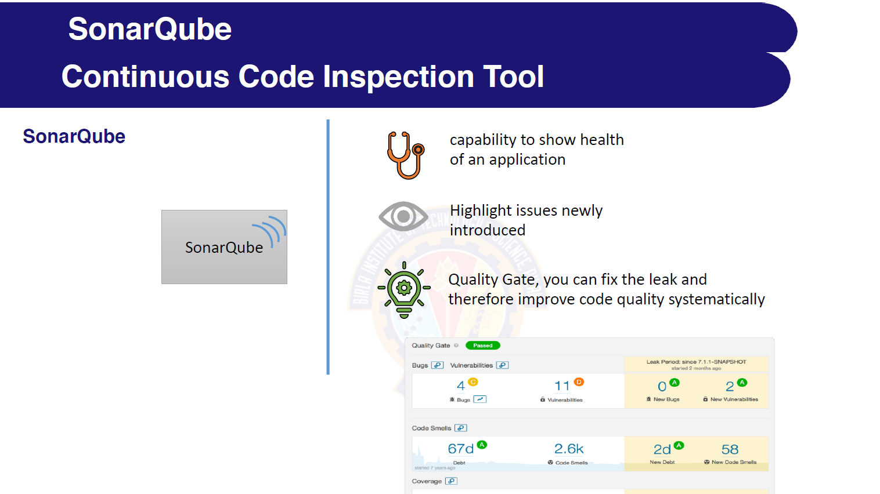

Slide 2
Terminology
Bug:
• An issue that represents something wrong in the code
• If this has not broken yet, it will, and probably at the
worst possible moment
Code Smell:
• A maintainability-related issue in the code
• Examples: Dead Code, Duplicate code, Comments,
Long method, Long parameter list, Long class etc.,
Vulnerability:
• A security-related issue which represents a backdoor
for attackers

Slide 3
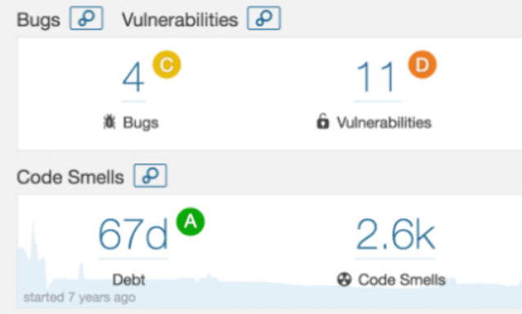
Status report

Slide 4
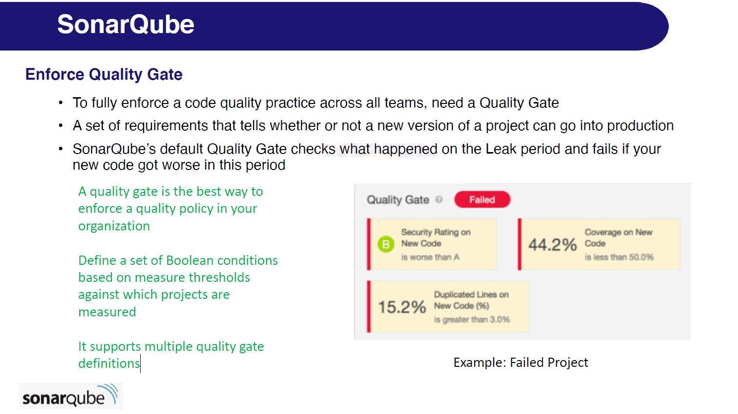

Slide 5
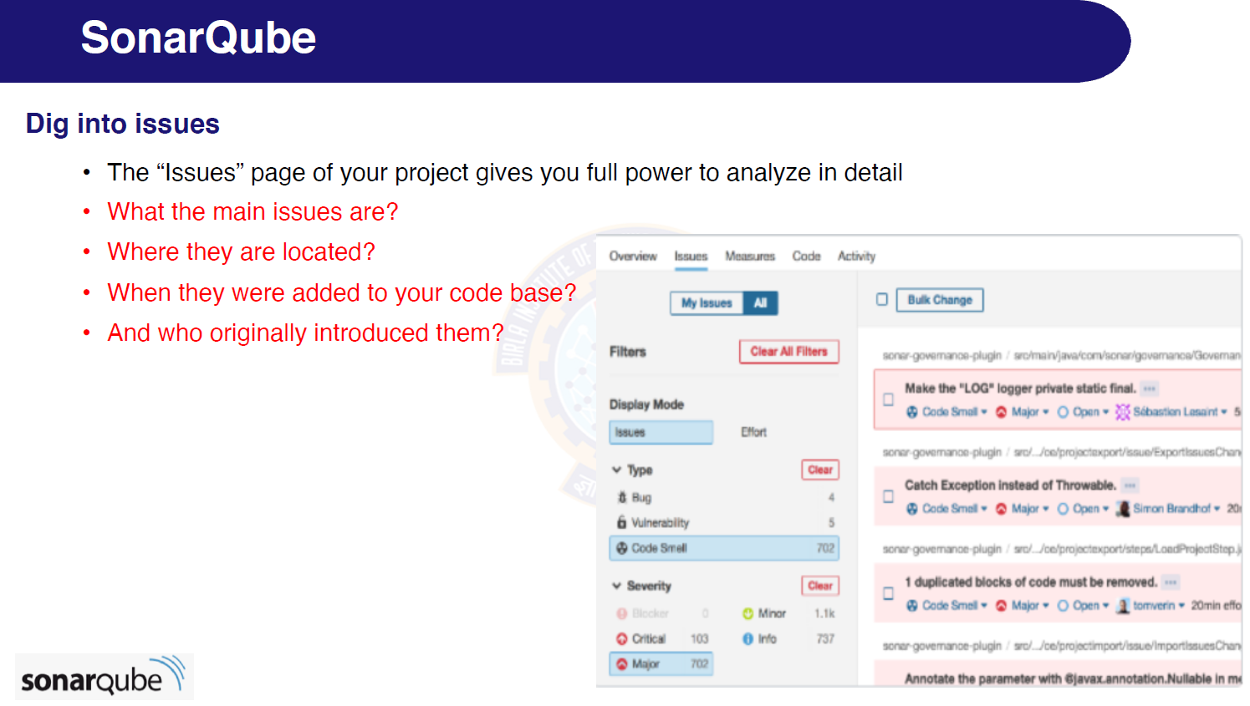

Slide 6
SAST
With the growing number of cybersecurity threats, you must ensure that your software is protected against potential vulnerabilities and threats. One of the most beneficial practices is to use static application security testing (SAST).
Link: https://devops.com/what-is-sast-overview-sast-tools/

Slide 7
DAST
Dynamic Application Security Testing (DAST) is the process of analyzing a web application through the front-end to find vulnerabilities through simulated attacks. This type of approach evaluates the application from the “outside in” by attacking an application like a malicious user would. After a DAST scanner performs these attacks, it looks for results that are not part of the expected result set and identifies security vulnerabilities.
Link: https://www.opentext.com/what-is/dast

Slide 8
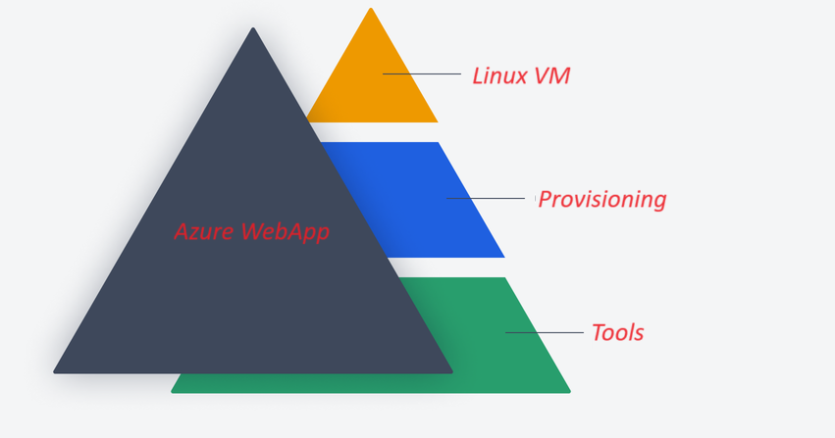
SCA> Scanning each possible layers

Slide 9
Static code analysis
Static code analysis, or static analysis, is a software verification activity that analyzes source code for quality, reliability, and security without executing the code. Using static analysis, you can identify defects and security vulnerabilities that can compromise the safety and security of your application.

Slide 10
GIT hub advance security
https://learn.microsoft.com/en-us/azure/devops/pipelines/tasks/reference/advanced-security-codeql-analyze-v1?view=azure-pipelines

Slide 11
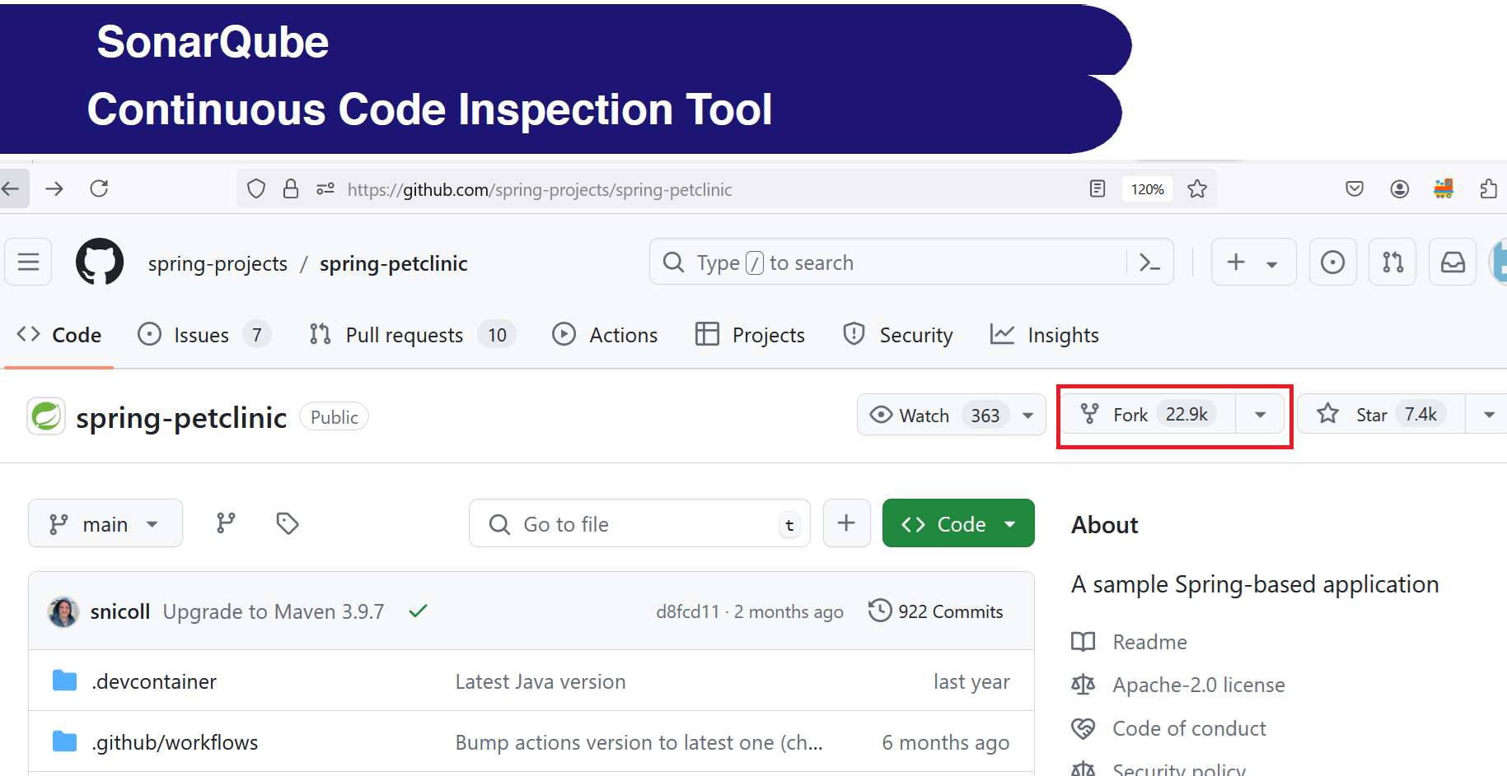

Slide 12
Fork[GIT fork]
Forking a repository means creating a copy of the repo. When you fork a repo, you create your own copy of the repo on your GitHub account. When several developers want to work on a project but need to make changes that are inappropriate for the original repository, forking is frequently used in open-source software development.
Source: https://www.geeksforgeeks.org/git-fork/

Slide 13
OWASP 10
The OWASP Top 10 is a standard awareness document for developers and web application security. It represents a broad consensus about the most critical security risks to web applications.
https://owasp.org/www-project-top-ten/

